Slide 1


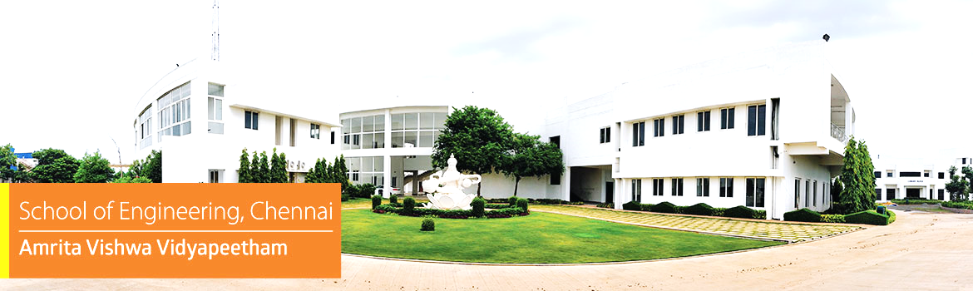



Embedded Systems Project
Ghost Vehicle in Fog Detector Using Pressure Wave Sensing Before Headlights Appear
Mentor :
Presented by :
Dr. C. Ganesh Kumar
Chairperson, Department of Electronics and Communication Engineering, School of Computing, Chennai
Akshaya M V - CH.EN.U4CCE24003
Devadharshini P - CH.EN.U4CCE24004
M Mukesh - CH.EN.U4CCE24015
1

Slide 2







Ghost Sense Initiative
The Edge-AI Solution
The Invisible Threat
Dense fog critically reduces visual range on highways and rural roads, rendering standard headlights ineffective.
Drivers face severely delayed detection of approaching vehicles, drastically increasing the likelihood of high-speed, catastrophic collisions.
A New Paradigm
The Technology Stack
Zero-Latency Intelligence
SENSE
PROCESS
WARN

Slide 3



Detecting approaching vehicles before they become visible by capturing the low-frequency pressure waves they push ahead of them.
Utilizes highly sensitive MEMS acoustic sensors. Processes physical data locally on a Cortex-M microcontroller.
Deploys TinyML and Edge-AI directly on the chip. Triggers life-saving early warnings without relying on:
SENSE
PROCESS
WARN
Capture invisible pressure disturbances generated by moving vehicles.
Trigger immediate driver alerts through:
Execute real-time signal analysis natively on a Cortex-M core.
Visual indicators (LEDs/Display) Audible alarms (Buzzer)

Slide 4





















LITERATURE SURVEY
Hardware
/Software
Outcome
S.NO
Title of the Paper
Year
Objective
Inference
1.
Adaptive Sensor Fusion for Robust Perception in Dense Fog: A Gated Vision and LiDAR Integration Framework
JUNE
2026
Improve obstacle detection in dense fog using adaptive multi-modal sensor fusion.
Hardware: Gated Camera, 3D LiDAR.
Software: AFW-Net, Attention-based Adaptive Fusion, Uncertainty Estimation, Cross-modal Feature Extraction.
Achieved 82% AP at 50 m visibility, improving detection by 23.7% over conventional RGB-LiDAR fusion.
Adaptive sensor weighting, Reliable sensor fusion, Robust fog perception
Develop an ensemble AI framework for accurate vehicle detection and classification under adverse weather.
Hardware: RGB Camera.
Software: YOLOv5, YOLOv7, YOLOv8, YOLOv10, DETR-ResNet50, Faster R-CNN, Dynamic Weighting, NMS, Ensemble Learning.
Achieved 96.6% mAP, 94.2% Precision, and 94.1% F1-score for multi-class vehicle detection.
Ensemble learning, High detection accuracy, Vision-dependent
2.
Ensemble Artificial Intelligence Framework for Real-Time Automatic Vehicle Detection and Classifications
MAY
2026
3.
FogGate-YOLO: Traffic Object Detection in Foggy Environments Using Channel Selection Mechanisms
MAR
2026
Design a lightweight object detector specifically optimized for foggy environments.
Hardware: RGB Camera.
Software: YOLOv12, A2C2f-FSA Module, Bidirectional Feature Fusion Module (BFFM), GSConv, F-WIoU v3 Loss.
Improved mAP@0.5 by 5.2% (RTTS) and 7.3% (VOC-FOG) while maintaining real-time inference.
Fog-aware feature enhancement, Real-time detection, Camera limitations
4.
FogFusion: Robust 3D object detection based on camera-LiDAR fusion for autonomous driving in foggy weather conditions
MAR
2026
Improve 3D object detection in fog using enhanced camera-LiDAR fusion.
Hardware: RGB Camera, LiDAR. Software: Depth Completion Network with Fog Convolution (DCFC), Flexible Cylindrical Voxel (FCV), Cylindrical Fusion Module (CFM).
Improved detection performance by ≥3.32% over baseline methods on KITTI-C.
Enhanced 3D perception, Virtual point clouds, Costly sensor fusion
5.
Dynamic Visibility Recognition and Driving Risk Assessment Under Rain–Fog Conditions Using Monocular Surveillance Imagery
JAN
2026
Estimate road visibility and driving risk under rain-fog conditions using roadside surveillance images.
Hardware: Monocular CCTV Camera.
Software: Koschmieder Scattering Model, Dark Channel Prior, Monte Carlo Simulation, Low Visibility Risk Field Force (LVRFF).
Achieved >86% visibility estimation accuracy and effectively identified high-risk driving zones.
Visibility estimation, Risk assessment, Infrastructure-based monitoring

Slide 5
OBJECTIVES
  To detect approaching vehicles before their headlights become visible by sensing the low-frequency pressure waves they push ahead of them, using a MEMS sensor.
  To condition the sensor signal (amplification and band-pass filtering with an LM358 op-amp) so that only the vehicle-related frequencies remain.
  To acquire the signal through the ADC of a Cortex-M microcontroller and clean it with digital filtering (moving average).
  To warn the driver with immediate visual alerts (LEDs, LCD/OLED display) and an audible alert (buzzer) before the vehicle becomes visible.
  To collect data from live moving vehicles, then test, calibrate and optimise the system for reliable detection.
  To build a complete working prototype and evaluate its performance, aiming to improve road safety in low-visibility conditions.

Slide 6
















Architecture & Data Pipeline
From physical pressure waves to real - time Edge-AI alerts.
Zone 1
Physical Sensing
Zone 2
Edge-AI Processing
Zone 3
Alert Execution
4. Data Acquisition
Vehicle Approaches
5. Digital Filtering
8. Confirmation
Acoustic Detection
6. Algorithmic Analysis
9. Early Warning
Signal Conditioning
7. Threshold Decision
10. Result
Pressure Waves > MEMS Sensor > Signal Conditioning > Cortex-M ADC > Digital Filtering > TinyML Analysis > Vehicle Detection > LED/LCD/Buzzer Alert > Driver Safety

Slide 7
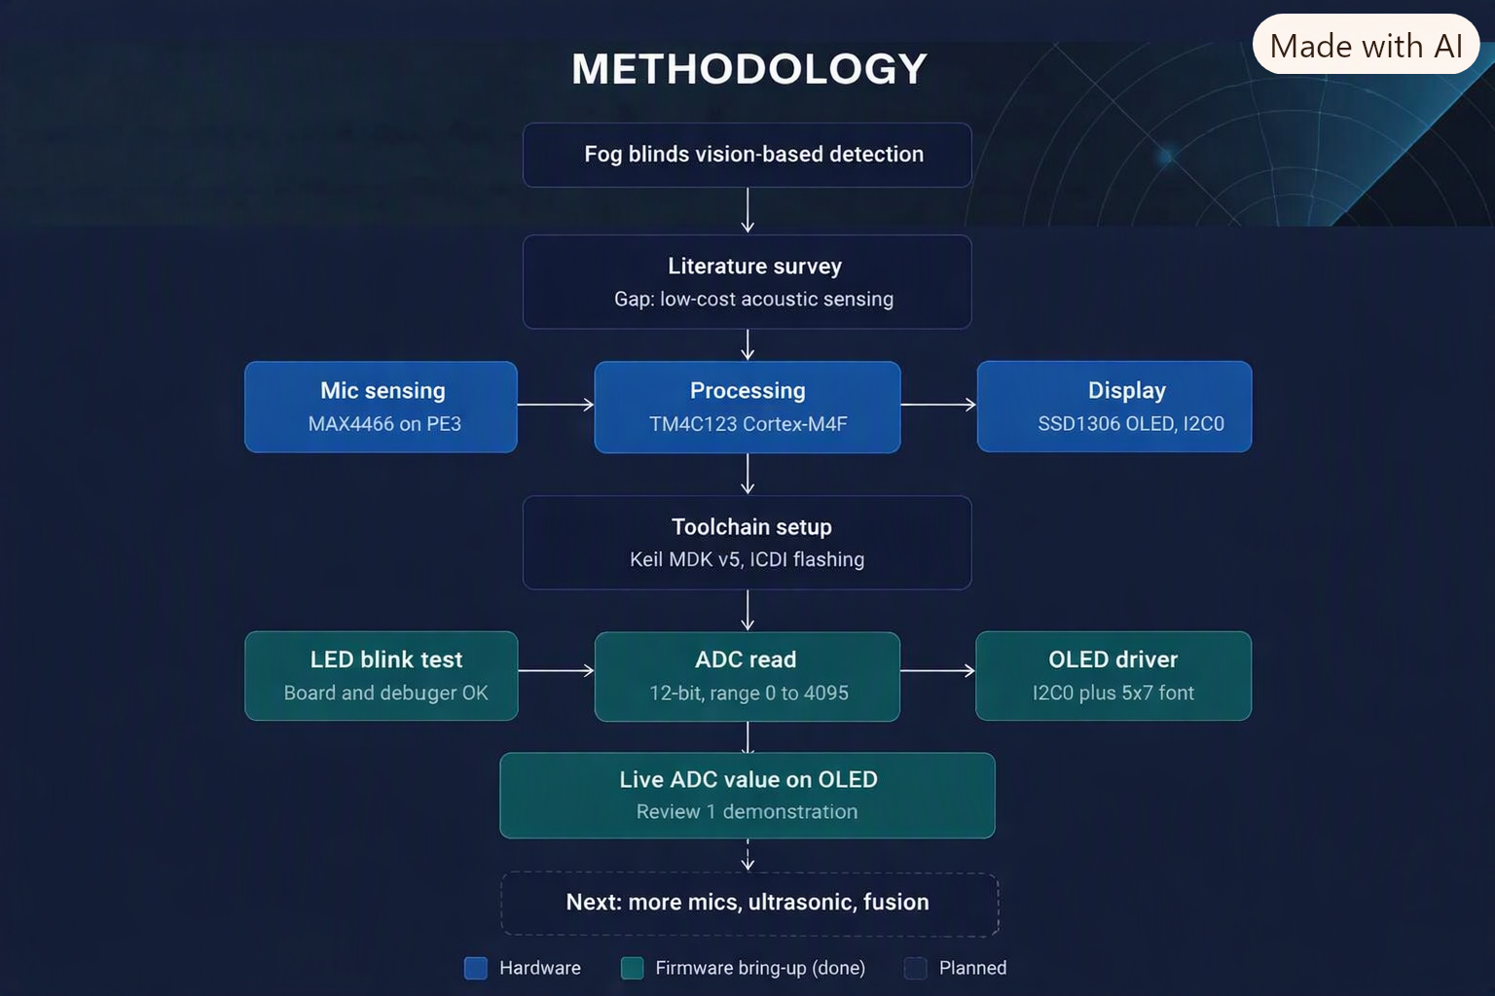
METHODOLOGY

Slide 8

Phase & Focus
Week
Core Activity
Literature Survey, Problem Analysis & Component Procurement.STM32/Cortex-M setup and architecture learning.
Key Milestone
Phase 1: Foundation(Research & Hardware)
Week 1-3
Hardware Procured & Environment Setup
Sensor Interfacing & ADC Testing.Data Collection from live moving vehicles.Initial Signal Processing Implementation.
Phase 2: Integration(Interfacing & Data)
Week 4 - 6
Successful Sensor Data Acquisition
Vehicle Detection Algorithm (TinyML) Development.LED, Buzzer, and Display Integration.System Testing, Calibration, and Optimisation.
Phase 3: Edge-AI(Algorithm & Alert)
Week 7 - 9
Functional Detection Algorithm
Complete Prototype Assembly.Result Analysis and Performance Evaluation.Report Writing and PPT Preparation.
Phase 4: Finalisation(Prototype & Delivery)
Week 10 - 12
Final Demonstration (Sept 20)

Slide 9





Hardware Ecosystem
Software Ecosystem
Compute
Output UI
Environment
Analysis Tools
Tiva C Board
Cortex-M Microcontroller
OLED Display / LCD (16×2)
Warning LEDs
Buzzer
Keil uVision5
MATLAB
Python
Used for initial signal analysis and algorithm modeling
Sensing
Programming Language
MEMS Microphone Sensor
MAX9814 / MAX4466
Ancillary Components
Embedded C Programming Optimized for TinyML constraints
Simulation & Debugging
USB Programmer / ST-Link
Breadboard
Power Supply
Serial Terminal
Conditioning
LM358 Operational Amplifier Used for signal amplification
PuTTY Tera Term
Proteus (optional for simulation)
Expected Output
Early Detection : Reliable identification of approaching vehicles completely obscured by dense fog.
Immediate Alert : Distinct visual and audible warnings delivered to the driver via the edge device with zero latency.
Ultimate Impact : Significantly improved road safety and a drastic reduction in collisions under critical low-visibility conditions.

Slide 10

Thank You !

